Slide 1
Infectious Diseases Protista and Protozoan Diseases
Protista
structure
Malaria
Pathogenic protozoan name, structure & ecology
Life cycle of the pathogenic fungi
Impact on host
Control
Phytophthora
Pathogenic protist name, structure & ecology
Life cycle of the pathogenic fungi
Impact on host
Control

Slide 2
Infectious Disease
Syllabus:
The major groups of organisms that cause disease are bacteria, fungi, protists and viruses; each group can be distinguished by its structural characteristics
The life cycle of a pathogen and its associated diseases, including the method of invading the host, the impact on the host, and the mode of transmission (direct or indirect), determines its success for survival
Describe the structure of protozoan
Describe the life cycle of a the pathogenic Protista that causes malaria and phytophthora (dieback)
Describe the modes of transmission of both disease above
Biozone
81 Protistan Diseases
82 Malaria: A protozoan Disease
Biology WA UNITS 3 & 4
Reading
Chapter 12 pages 420 – 422
Chapter 13 pages 446 - 450
Questions
Set 12.3b pg.422 Q1 – 7
Set 13.3 page 450 Q1 – 5
Essential
Question:
Topic Question 1: Briefly describe a protista

Slide 3
Topic Question 2:
List the structural characteristics of protista
Viruses | Bacteria | Fungi | Protista
Topic Question 3:
Compare the structural characteristics of viruses, bacteria, fungi and protista

Slide 4
Topic Question 4:
State the name of 4 the most common pathogenic protozoans that causes Malaria in humans
Topic Question 5:
List the structural characteristics of the Malaria Plasmodium

Slide 5
Topic Question 6:
Describe the ecology of Plasmodium
Topic Question 7:
Describe the distribution of Malaria

Slide 6
Topic Question 8:
Describe how the distribution of Malaria is projected to change with climate change
Topic Question 9:
Why will the distribution of Malaria change with a changing climate?

Slide 7
Topic Question 10:
Describe the mode of transmission of malaria & how this mode of transmission influences the spread of Malaria

Slide 8
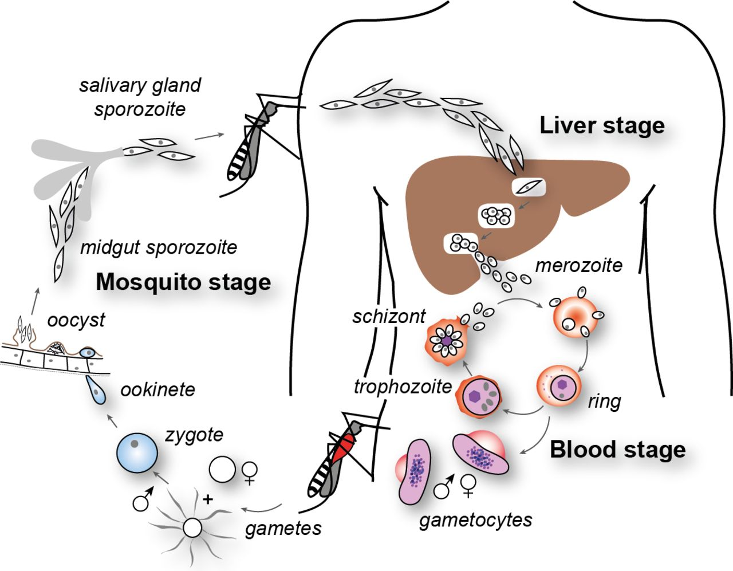
Topic Question 11: Describe the life cycle of Plasmodium

Slide 9
Topic Question 12:
Describe how impact of Malaria on the host
This is the symptoms
Read page 421 Biology WA ATAR Units 3 & 4
Topic Question 13:
State the incubation period of Malaria

Slide 10
Topic Question 14: Describe the management strategies that can be used to control the spread of malaria
Disruption of pathogen life cycle | Medications (treatments) | Physical preventative measures
Control Vector

Slide 11
Topic Question 15: What factors make Malaria difficult to control?

Slide 12
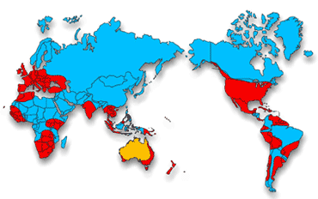
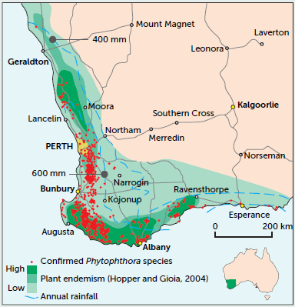
Topic Question 16:
State the name of the pathogenic protist that causes Phytophthora dieback an the organism it infects
Topic Question 17:
List the structural characteristics of the pathogen
Topic Question 18:
Describe the distribution of the pathogen & suggest a reason why the pathogen can be found in these areas?

Slide 13
Topic Question 19:
Describe the mode of transmission
How does this impact the spread of the disease?
Topic Question 20:
List the impacts on the host

Slide 14
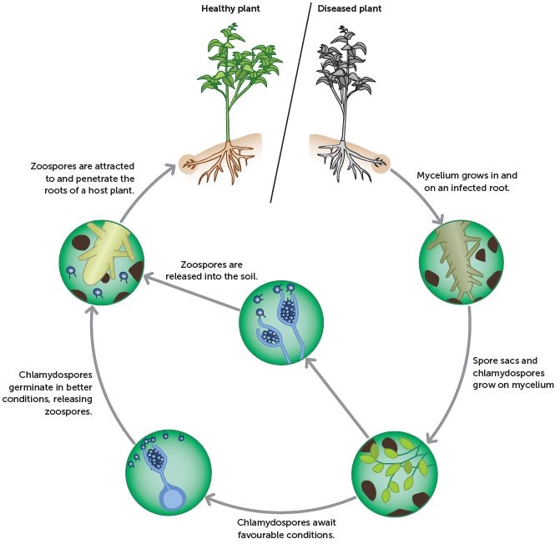
Topic Question 21: Describe the life cycle of Phytophthora

Slide 15
Topic Question 22: Describe how phytophthora dieback can be controlled (management Strategies)
Topic Question 23: What factors make phytophthora difficult to control?

Slide 16
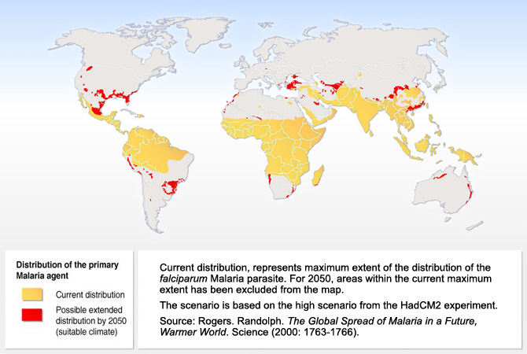
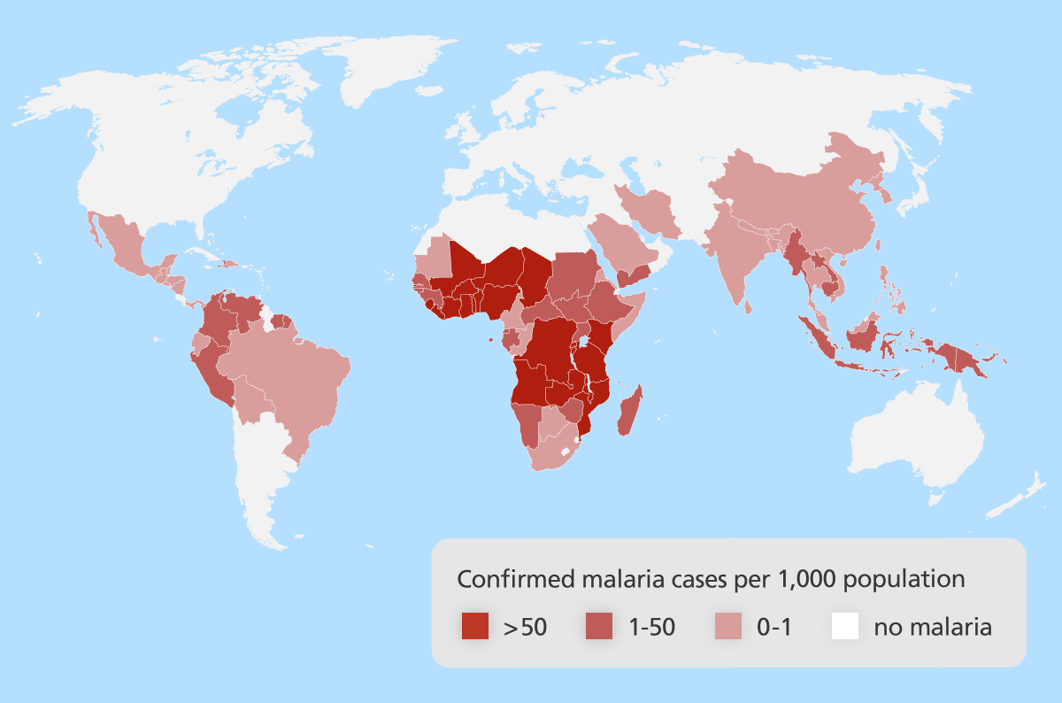
Malaria
Pathogen & Pathogen Structure:
Effect of Climate Change
Distribution
Vector:
Control – management Strategies
Mode of Transmission:
Symptoms & Impact on Host

Slide 17
Pathogen & Pathogen Structure:
Phytophthora
Mode of Transmission:
Distribution:
Symptoms & Impact on Host
Control:

